Slide 1
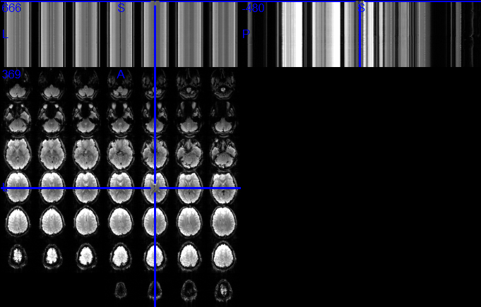
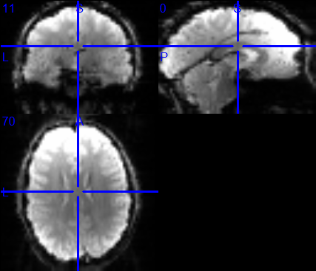
Figure #. The comparison between conversion functions from oro.dicom package (A) and from our Brainbase package (B). Our function showed better compatability with widely-used visualization tools (e.g., MRIcron).

